Slide 1
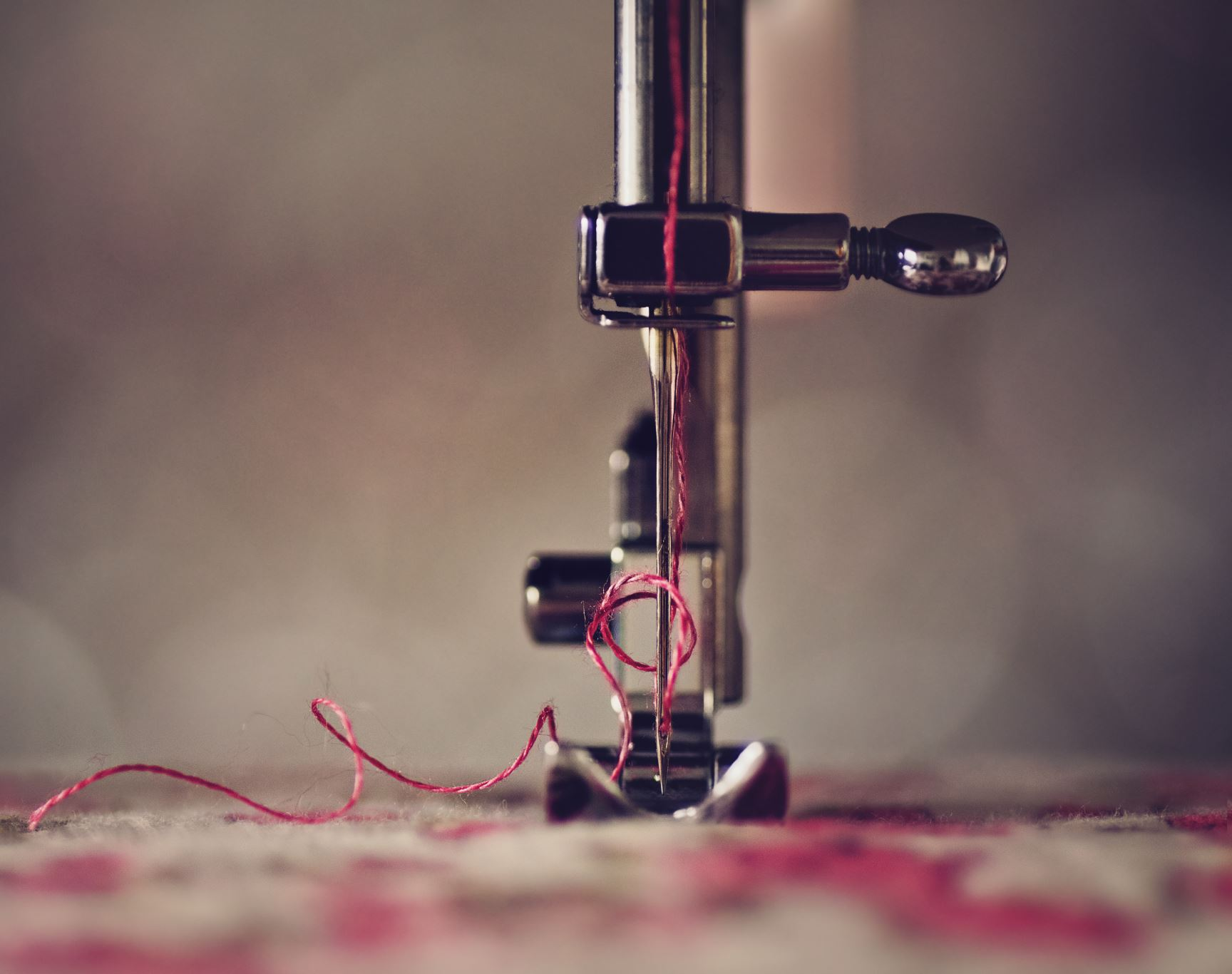
Image Stitching
Group 23
Hiten Chadha-s210208
Sahas Arora-s202555
Minki Chun-s20253
Jakub Szreder- s202643

Slide 2
(Add a flowchart for image stitching)

Slide 3
Step 1: Detect Interest Points in images using Feature Extractors
Extract SIFT descriptors (blobs) as they are scale and rotation invariant.

Slide 4
Step 2: Match Interest points
There should be an overlapping area in 2 images
BFMatcher, K-nearest neighbour(knn)
Add result snips

Slide 5
Step 3: Find Geometric relationship between images
Find homography transformation between 2 images
RANSAC to deal with outliers

Slide 6
Step 4: Warping
Take one image as reference image and align points on the other image(target image) so the corresponding points match
Basically, applying homography matrix to the image

Slide 7
Step 5: Image blending(Not implemented in our code currently)
To create a seamless single image without any seams between overlapping images

Slide 8
Conclusion OR Future scope maybe
What all problems we faced with the algorithm/code
Maybe do multiple images as future scope?
References – OpenCV library

